Slide 2
Antra SEP Program
Webapp_architecture
Advanced Java slide 2

Slide 3
Set Up Environment
JDK
STS
MySQL Server(community edition)
MySQL WorkBench
Apache Tomcat
NotePad ++

Slide 4
Start Tomcat /bin/startup.bat
Shut Down Tomcat /bin/shutdown.bat
On unix systems ./startup.sh
./shutdown.sh
Create and deploy first website
Create a sample html page inside the website

Slide 5
What is a Container?
Servlets don’t have a main() method. They’re under the control of another Java application called a Container.
Tomcat is an example of a Container. When your web server application (like Apache) gets a request for a servlet (as opposed to, say, a plain old static HTML page), the server hands the request not to the servlet itself, but to the Container in which the servlet is deployed. It’s the Container that gives the servlet the HTTP request and response, and it’s the Container that calls the servlet’s methods (like doPost() or doGet()).

Slide 6
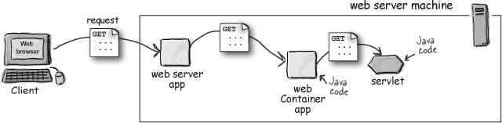
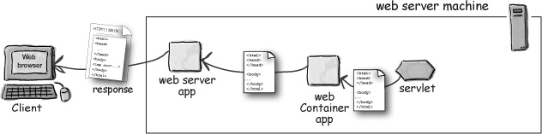

Slide 7
What does the Container give you?
Communications support The container provides an easy way for your servlets to talk to your web server. You don’t have to build a ServerSocket, listen on a port, create streams, etc. The Container knows the protocol between the web server and itself, so that your servlet doesn’t have to worry about an API between, say, the Apache web server and your own web application code. All you have to worry about is your own business logic that goes in your Servlet (like accepting an order from your online store).
Lifecycle Management The Container controls the life and death of your servlets. It takes care of loading the classes, instantiating and initializing the servlets, invoking the servlet methods, and making servlet instances eligible for garbage collection. With the Container in control, you don’t have to worry as much about resource management.
Multithreading Support The Container automatically creates a new Java thread for every servlet request it receives. When the servlet’s done running the HTTP service method for that client’s request, the thread completes (i.e. dies). This doesn’t mean you’re off the hook for thread safety—you can still run into synchronization issues. But having the server create and manage threads for multiple requests still saves you a lot of work.
Declarative Security With a Container, you get to use an XML deployment descriptor to configure (and modify) security without having to hard-code it into your servlet (or any other) class code. Think about that! You can manage and change your security without touching and recompiling your Java source files.
JSP Support You already know how cool JSPs are. Well, who do you think takes care of translating that JSP code into real Java? Of course. The Container.

Slide 8
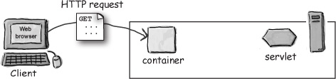
How the Container handles a request?
User clicks a link that has a URL to a servlet instead of a static page.

Slide 9
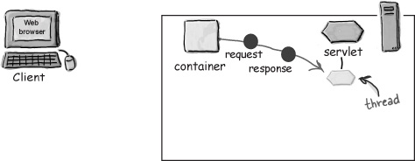
The container “sees” that the request is for a servlet, so the container creates two objects:
1) HttpServletResponse
2) HttpServletRequest

Slide 10
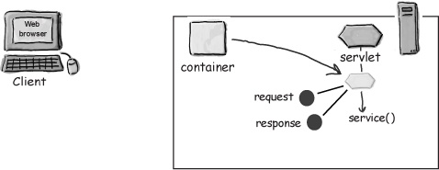
The container finds the correct servlet based on the URL in the request, creates or allocates a thread for that request, and passes the request and response objects to the servlet thread.

Slide 11
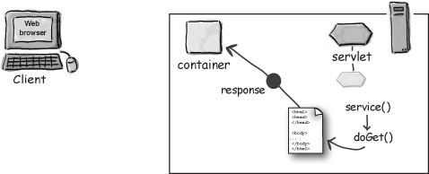
The container calls the servlet’s service() method. Depending on the type of request, the service() method calls either the doGet() or doPost() method.
For this example, we’ll assume the request was an HTTP GET.

Slide 12
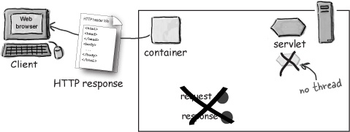
The thread completes, the container converts the response object into an HTTP response, sends it back to the client, then deletes the request and response objects.

Slide 13
A servlet can have THREE names
A servlet has a file path name, obviously, like classes/registration/SignUpServlet.class (a path to an actual class file). The original developer of the servlet class chose the class name (and the package name that defines part of the directory structure), and the location on the server defines the full path name. But anyone who deploys the servlet can also give it a special deployment name. A deployment name is simply a secret internal name that doesn’t have to be the same as the class or file name. It can be the same as the servlet class name (registration.SignUpServlet) or the relative path to the class file (classes/registration/SignUpServlet.class), but it can also be something completely different (like EnrollServlet).
Finally, the servlet has a public URL name—the name the client knows about. In other words, the name coded into the HTML so that when the user clicks a link that’s supposed to go to that servlet, this public URL name is sent to the server in the HTTP request.

Slide 14
